Slide 3
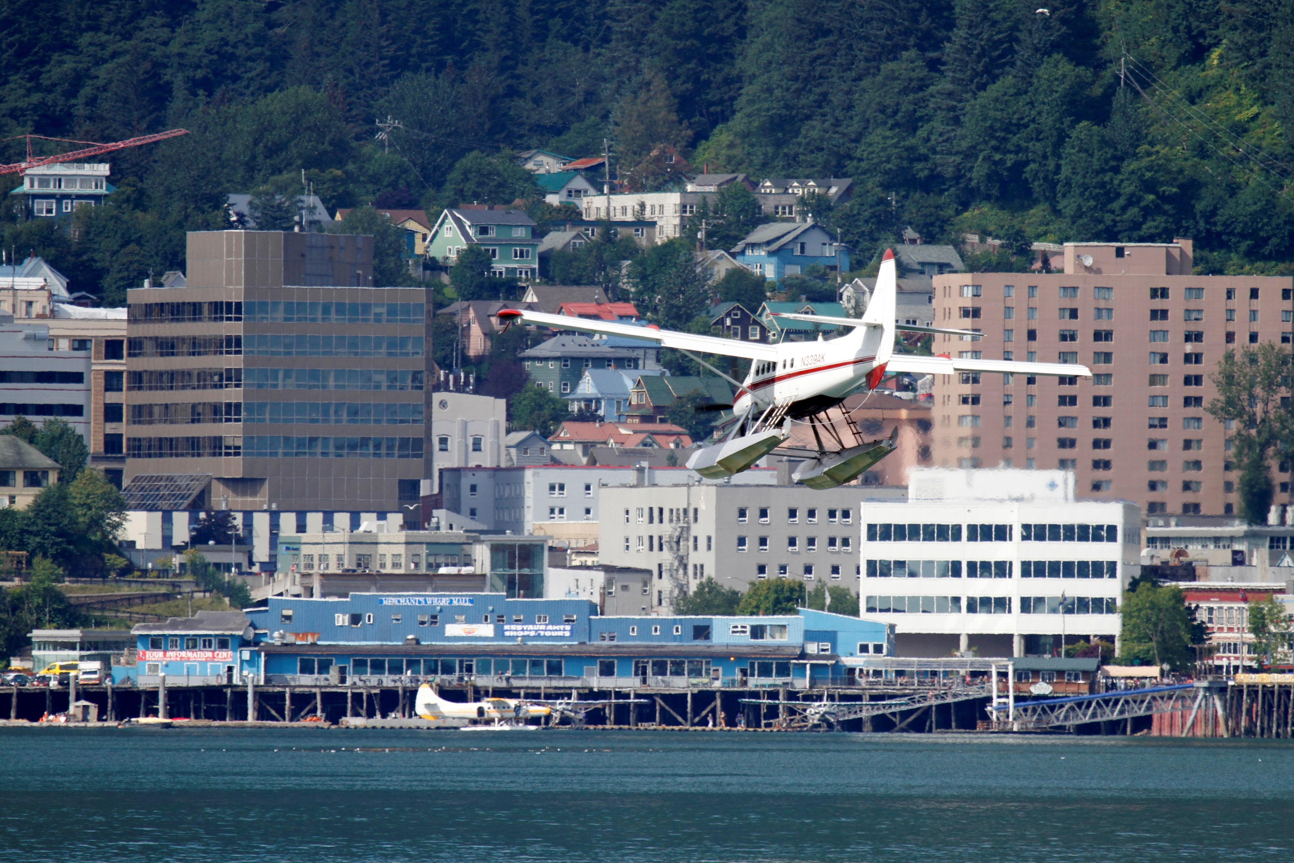
In 1997, in response to growing concerns about the impact of tourism on the community, local tourism operators took the initiative to develop the Voluntary Compliance Program – over time, this evolved into TOURISM BEST MANAGEMENT PRACTICES, or TBMP.

Slide 4
“This program is a cooperative effort by tour operators, cruise lines, transportation providers and the City & Borough of Juneau. The TBMP program is intended to minimize the impacts of tourism in a manner which addresses both resident and industry concerns.”
- TBMP Guidelines

Slide 5
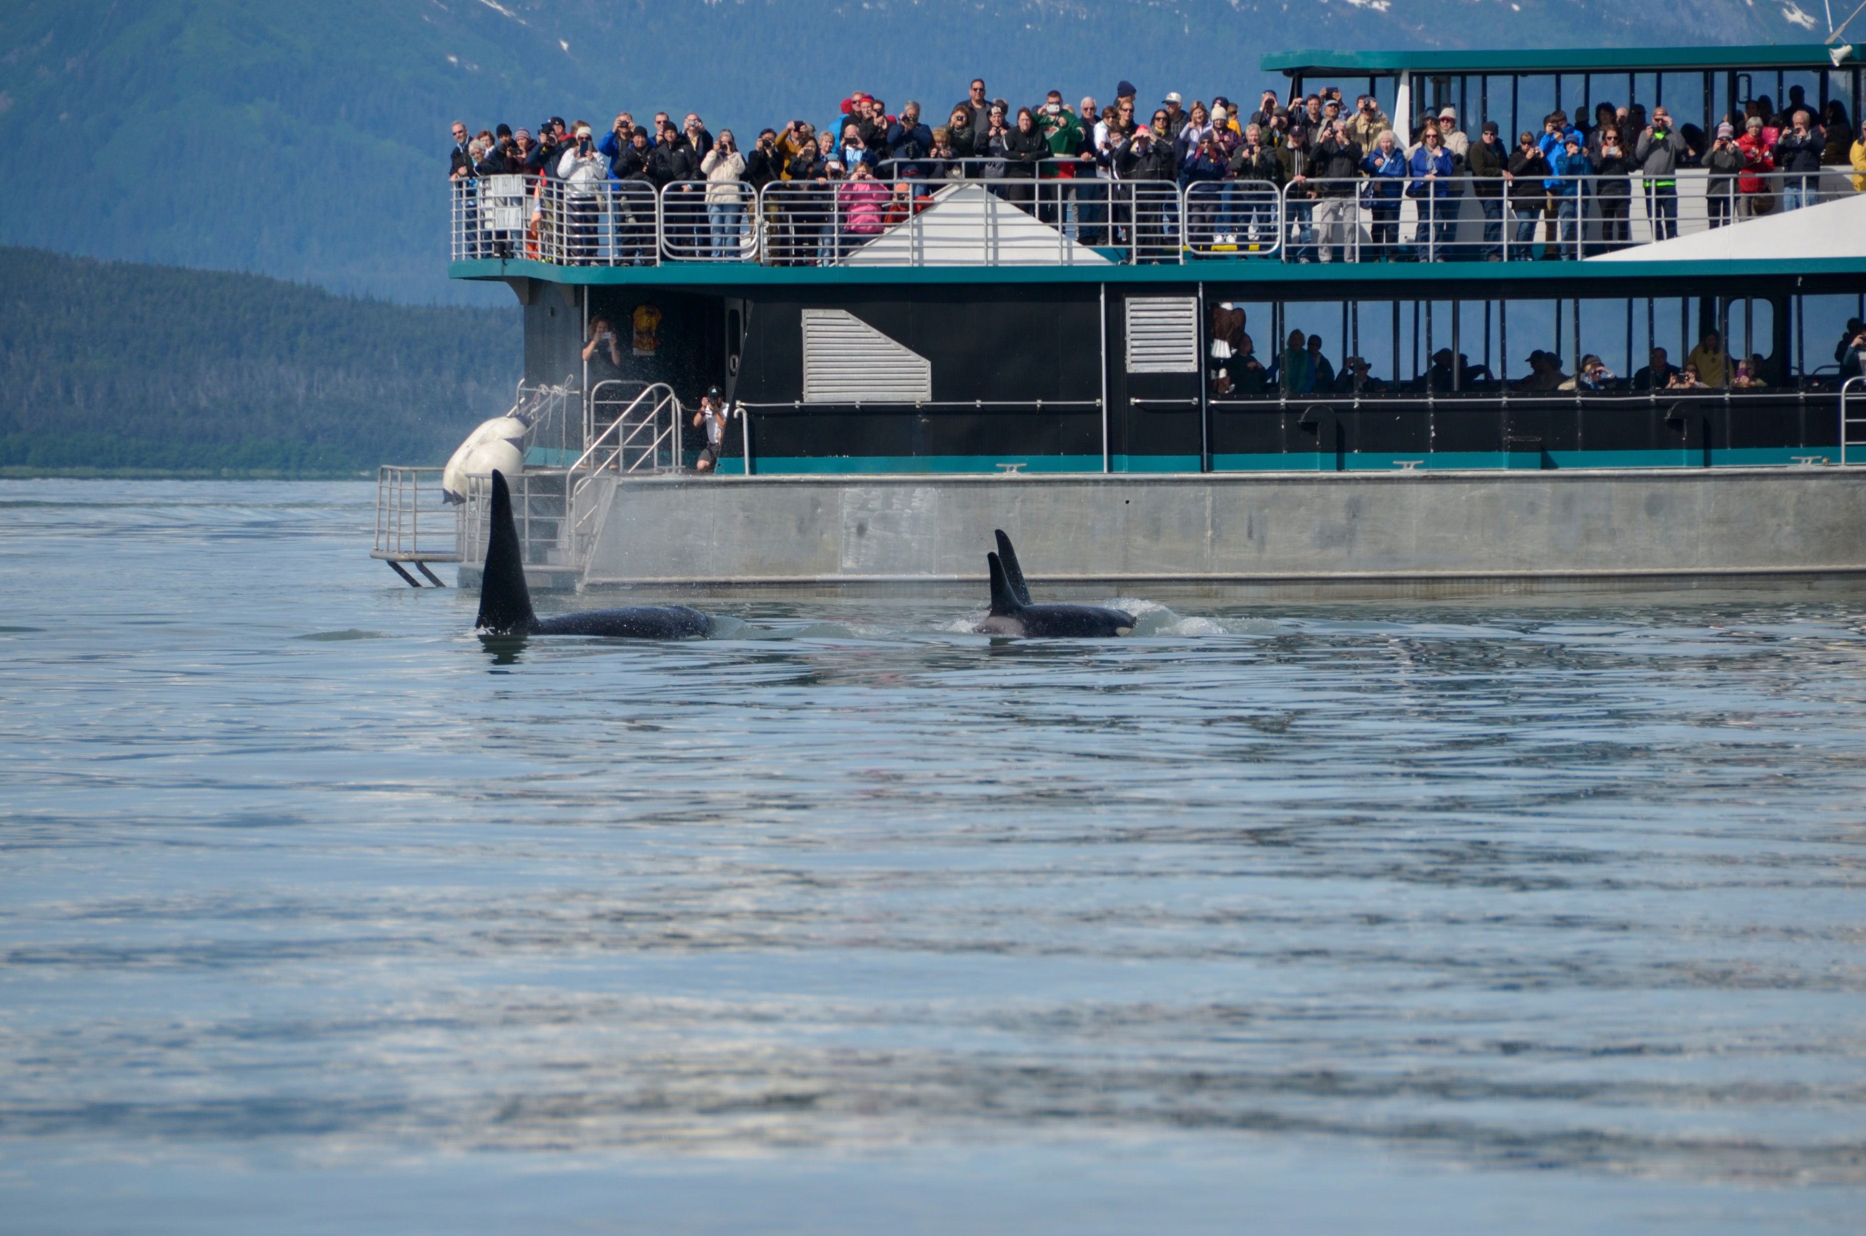
PROACTIVE
vs
REACTIVE

Slide 6
TBMP was formed to address and better manage impacts to Juneau from its growing tourism industry:
Congestion
Flightseeing noise
Ship emissions
Commercial use of trails
Carrying capacity – infrastructure and technology
Marine tours and fishing charters; wake management
Low-impact whale watching
Pedestrian traffic

Slide 7
Guidelines
example

Slide 8
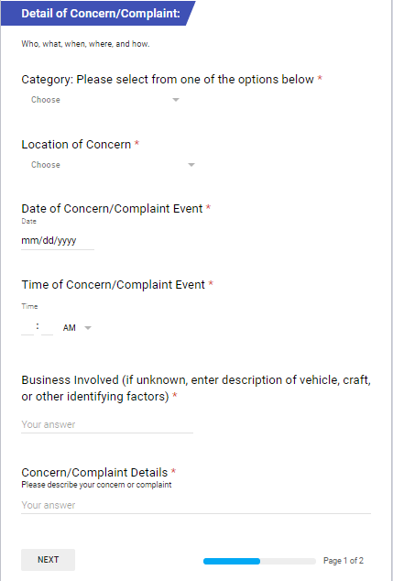
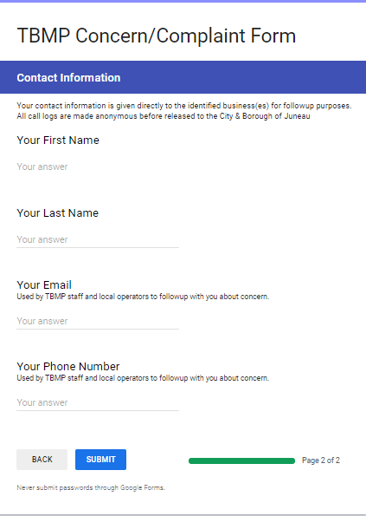
Online concern form
www.tbmp.info

Slide 9
TBMP hotline log sheet

Slide 10
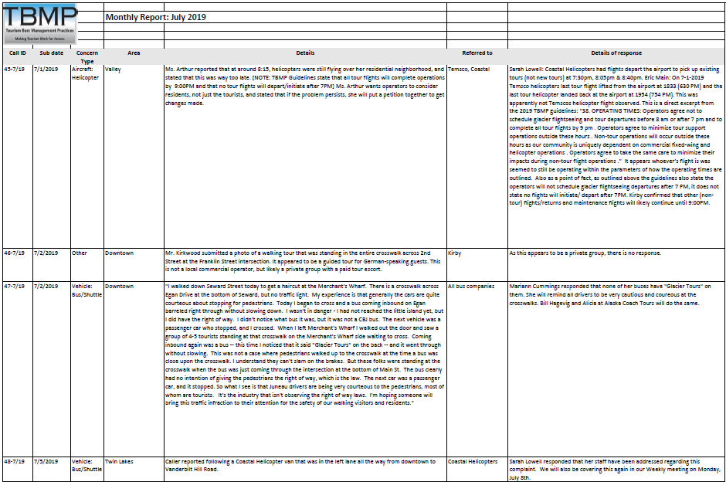
Hotline call log

Slide 11
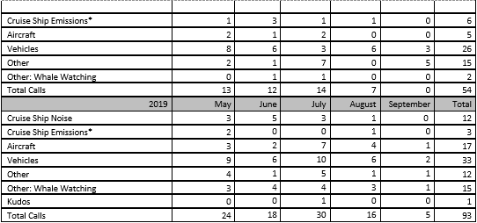
Hotline Summary: 1997 = 285 calls
2000 = 248 calls
2019 = 93 calls

Slide 12
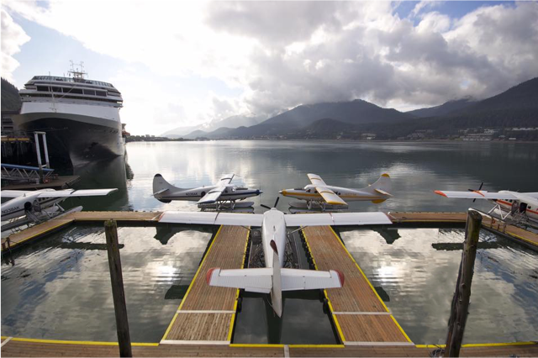
QUIETER ON THE WATERFRONT
For example, Wings Airways modernized their fleet by converting 4 De Havilland Otter aircraft from piston engines to modern, quiet, reliable turbine power plants. These conversions have added flexibility and a very high degree of safety to the overall operations. They have also provided the community of Juneau with a decrease in floatplane noise.

Slide 13
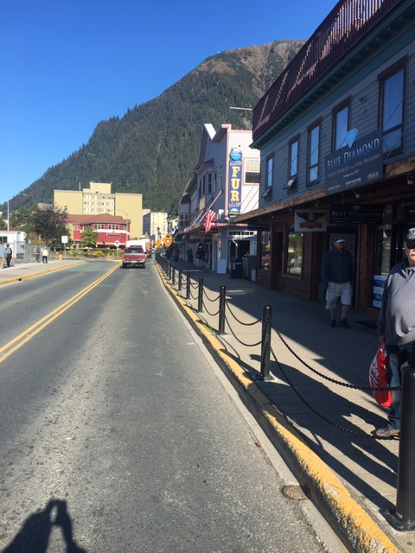
Ongoing efforts include
Community
Operators
Employees
TBMP outreach
Awareness
Action
Accountability

Slide 14
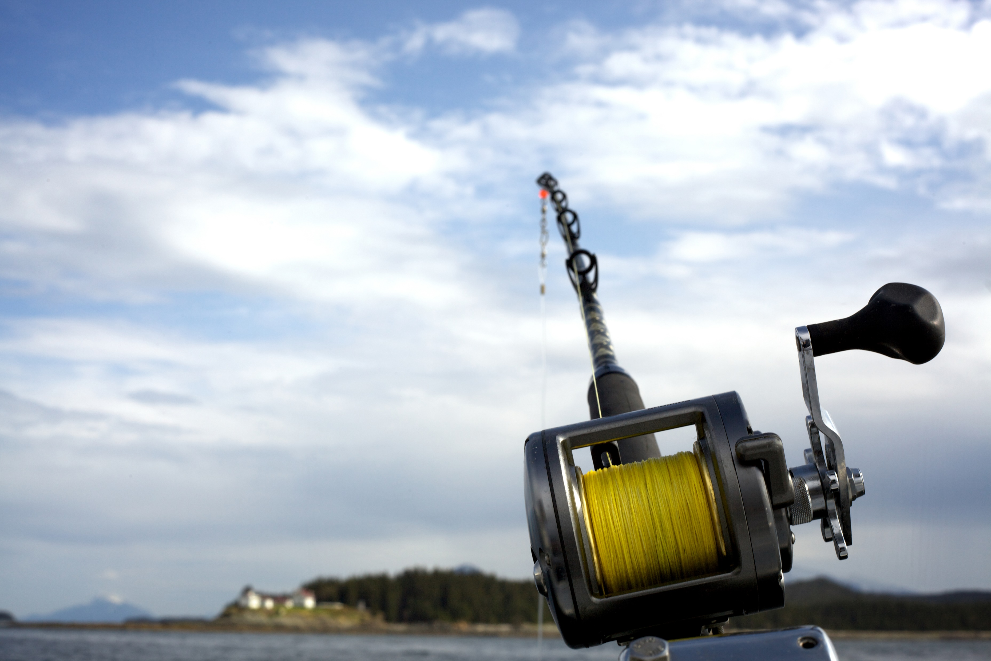
Elements necessary for success:
Buy-in from
Community
Tour Operators
Local government
Plus continuous communication, accountability, and review by all parties

Slide 15
Thank you!
You can find more information at the TBMP website: www.tbmp.info
Kirby Day – kday@hagroup.com
Liz Perry – liz.perry@traveljuneau.com

